Slide 1


Quantum &
Technology Transformation
Col Kapil Jaiswal(R)
CTO , Quantum AI Global & QuLabs

Slide 2
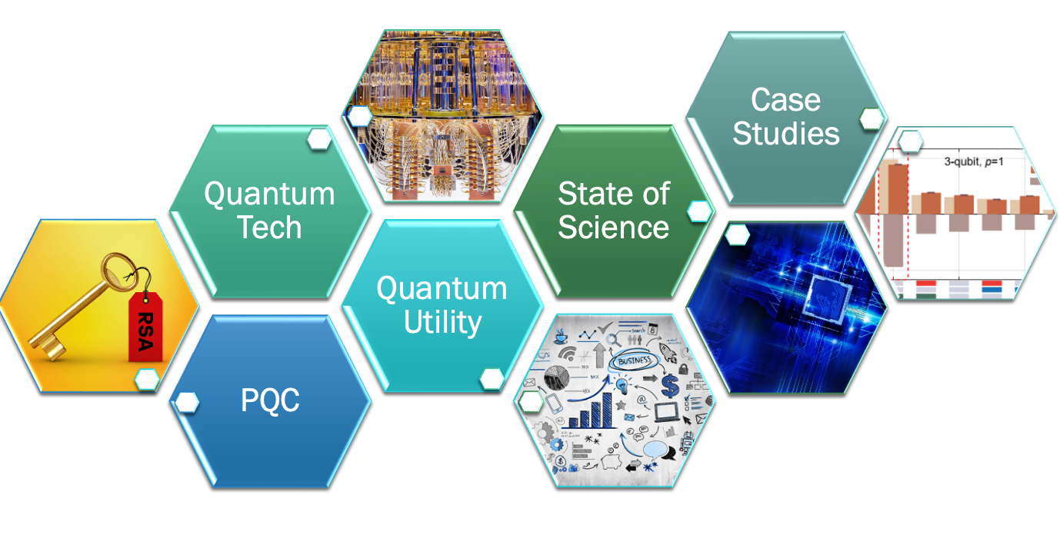
Quantum Landscape

Slide 3
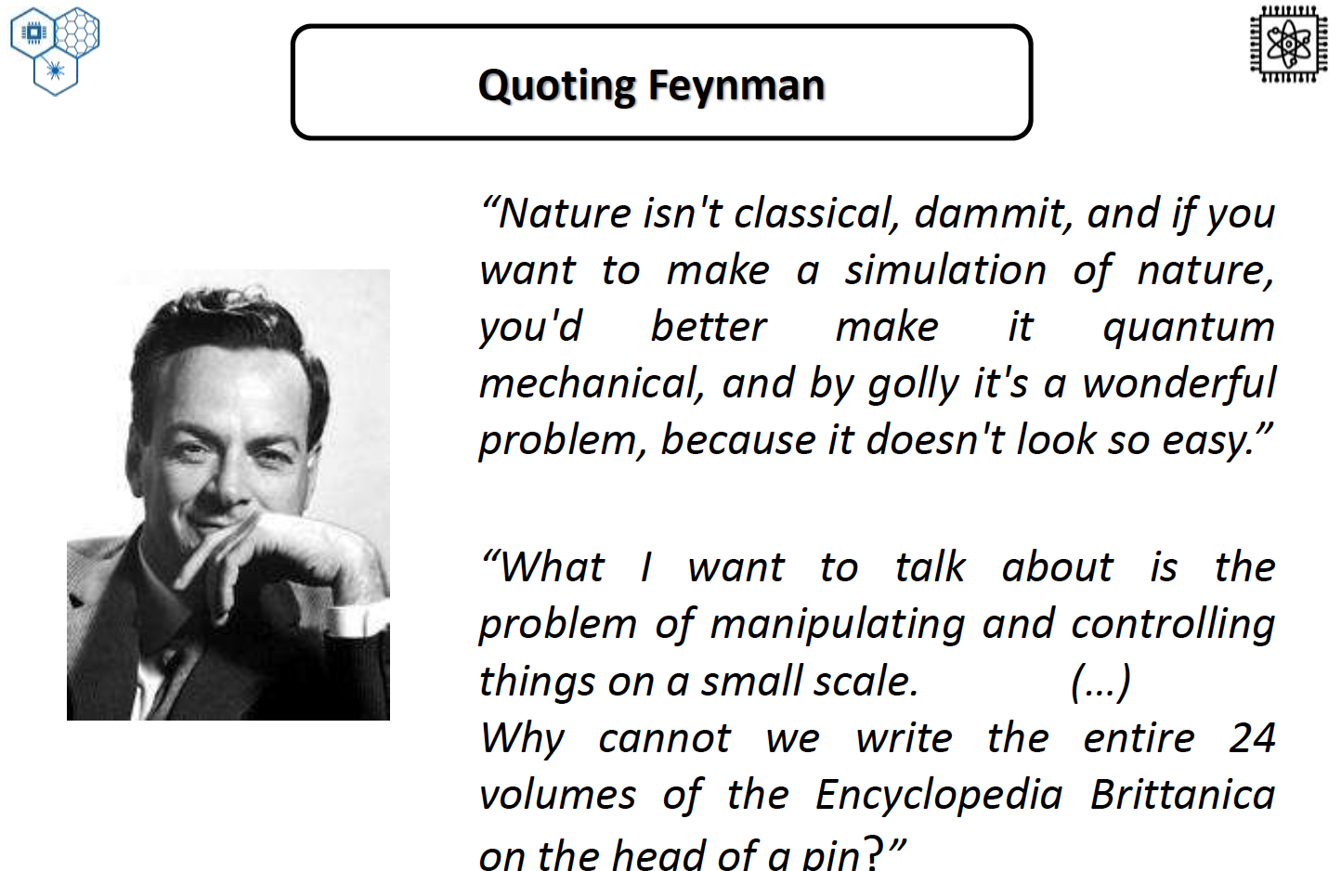

Slide 4
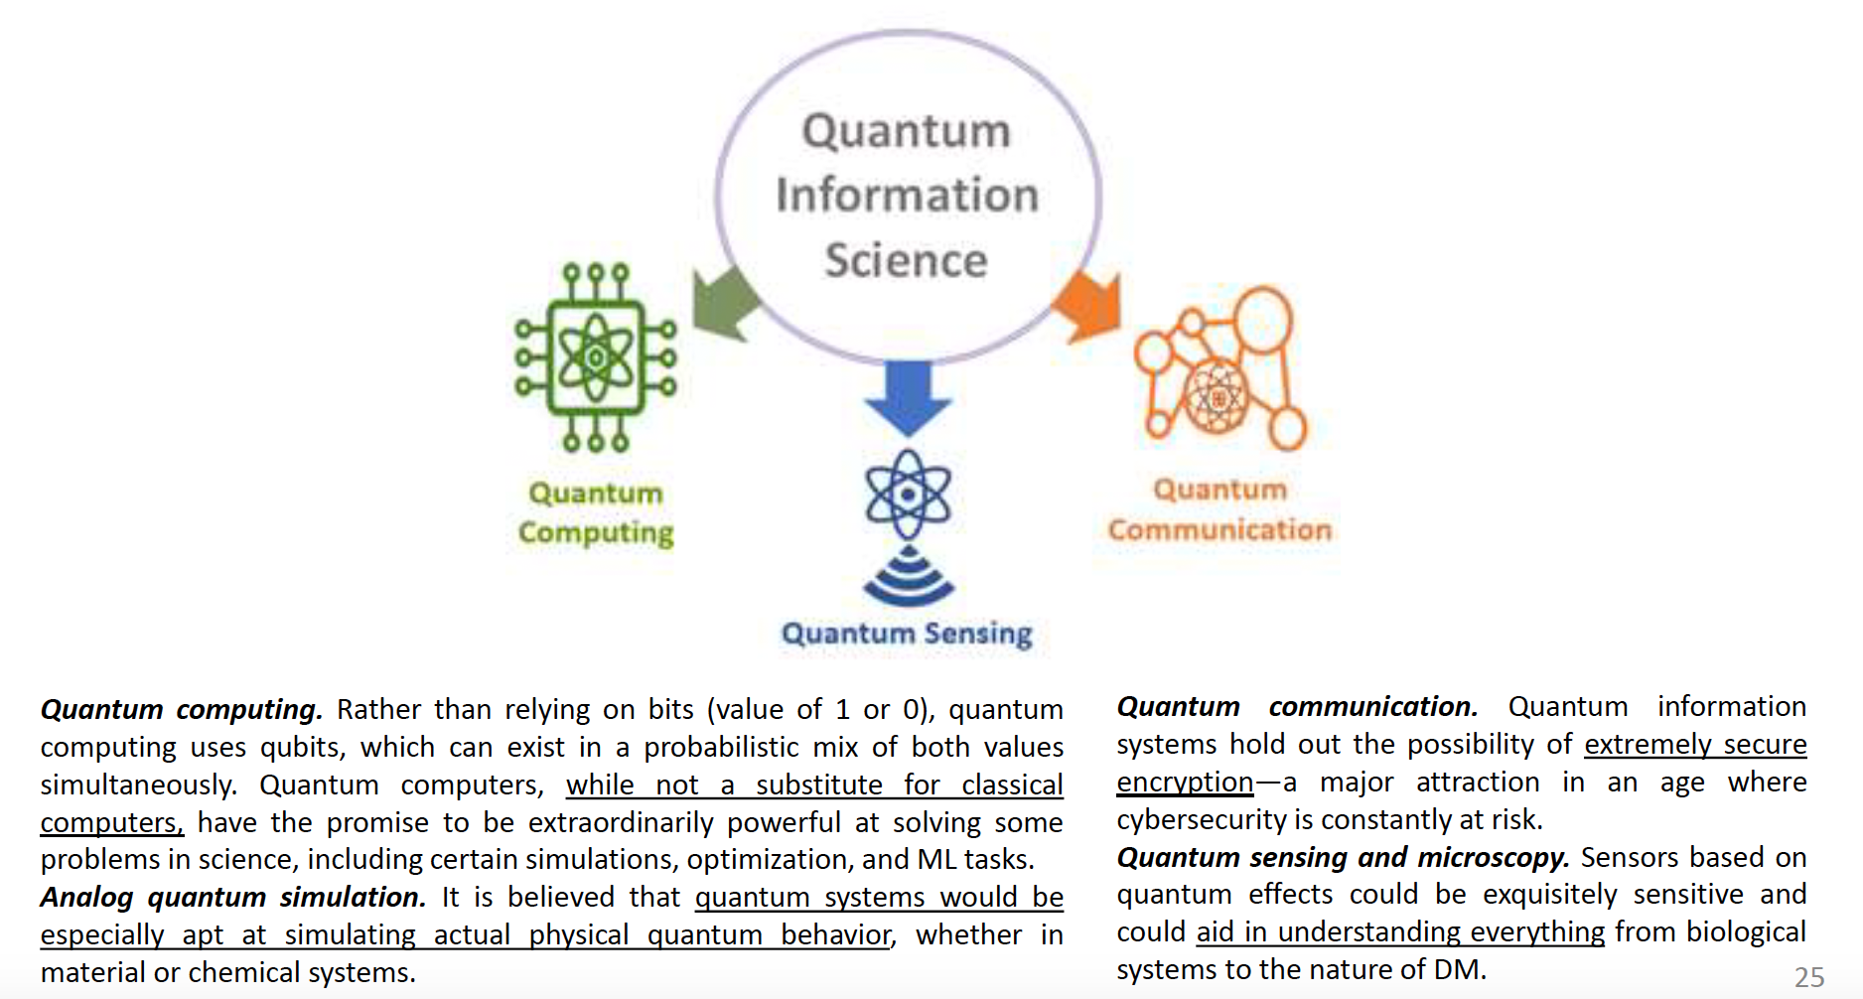
Quantum Information Science

Slide 5
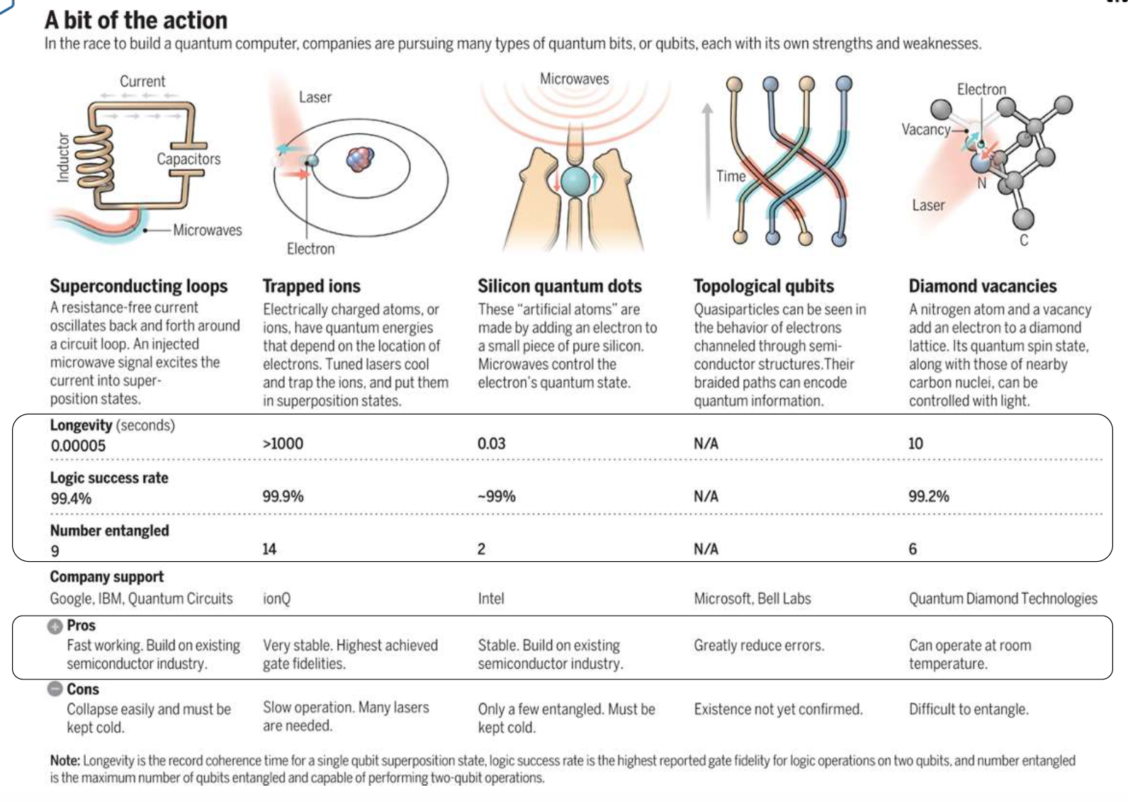
Quantum Material & Devices

Slide 6
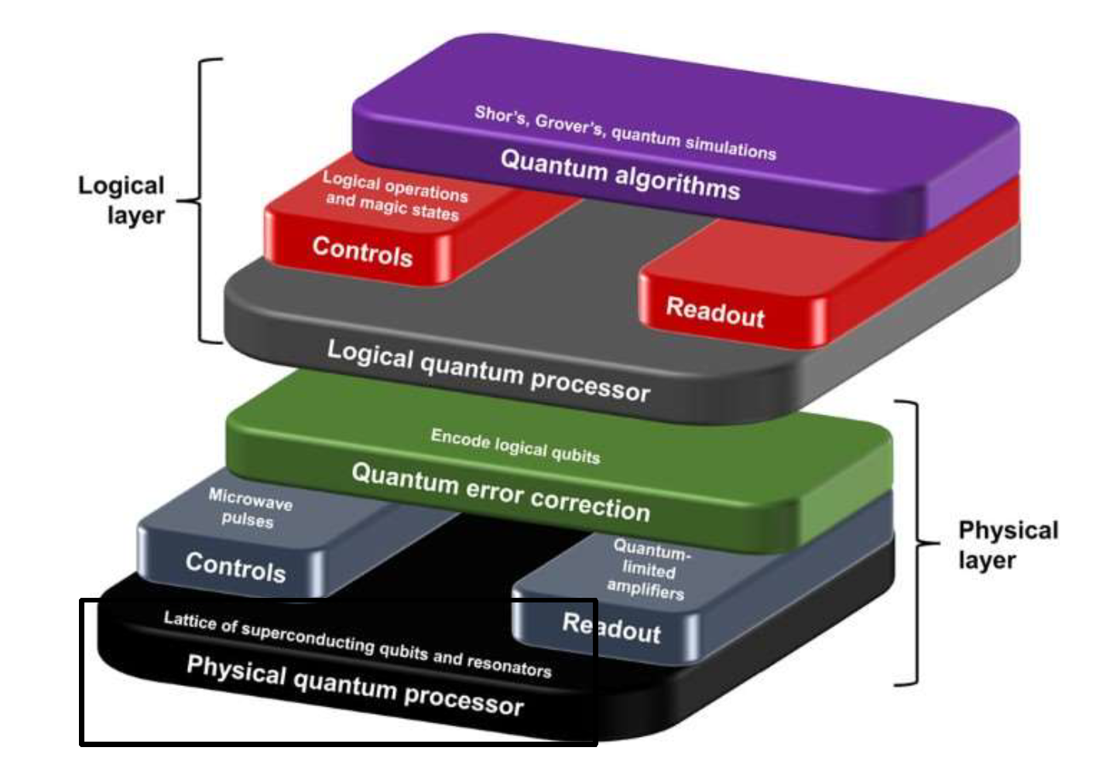
Quantum Computing : Abstraction

Slide 7
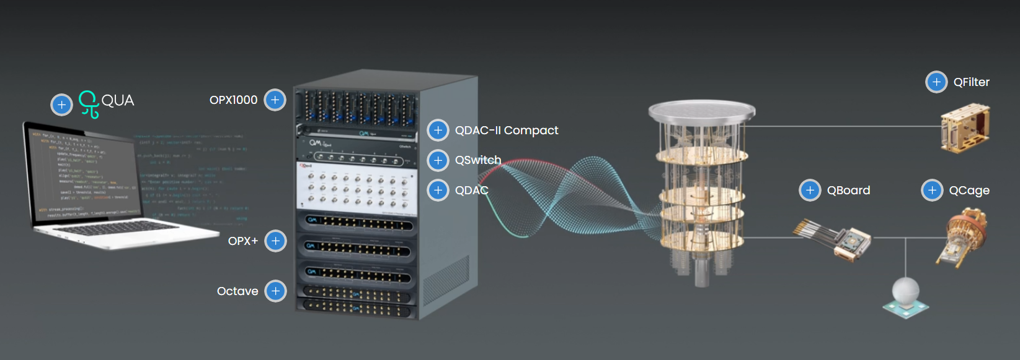
Quantum Computing : Workflow

Slide 8
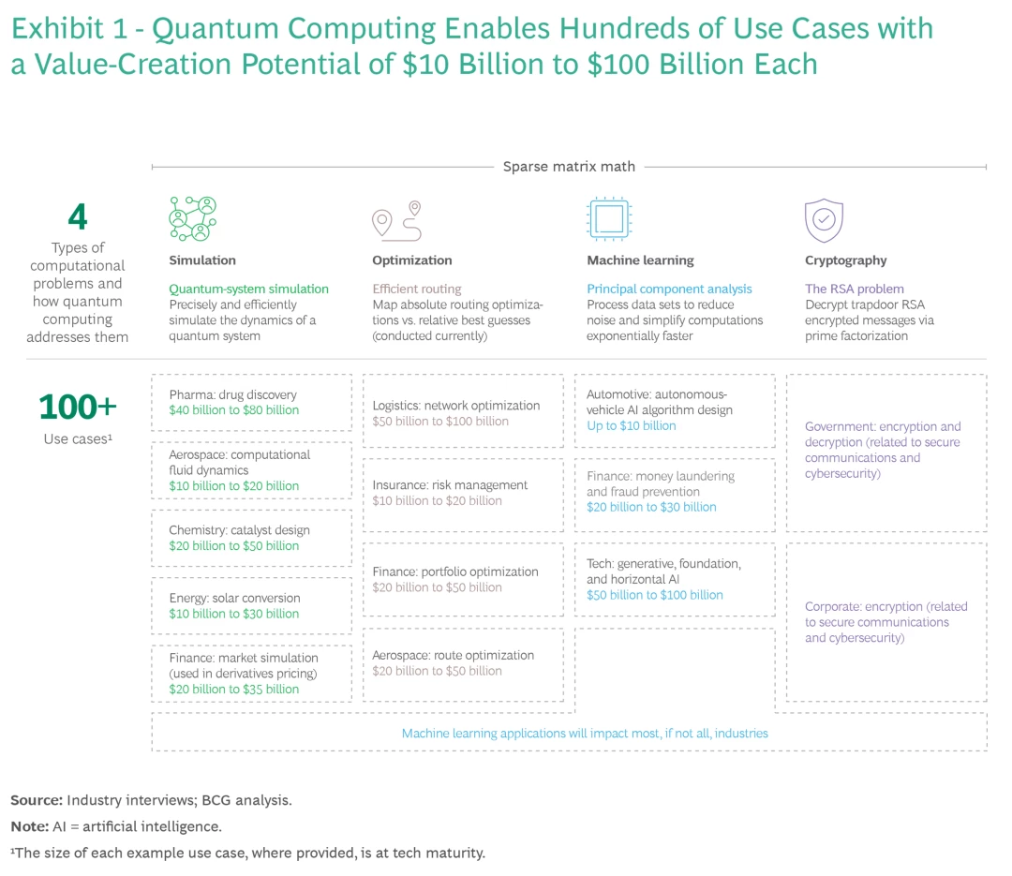
Advantage: Quantum Computing
Reducing the Computational Complexity of certain Classes of Problems e.g. Optimization , Sampling, Combinatorial , Factorization
Combinatorial Optimization
Non-Convex Optimization

Slide 9
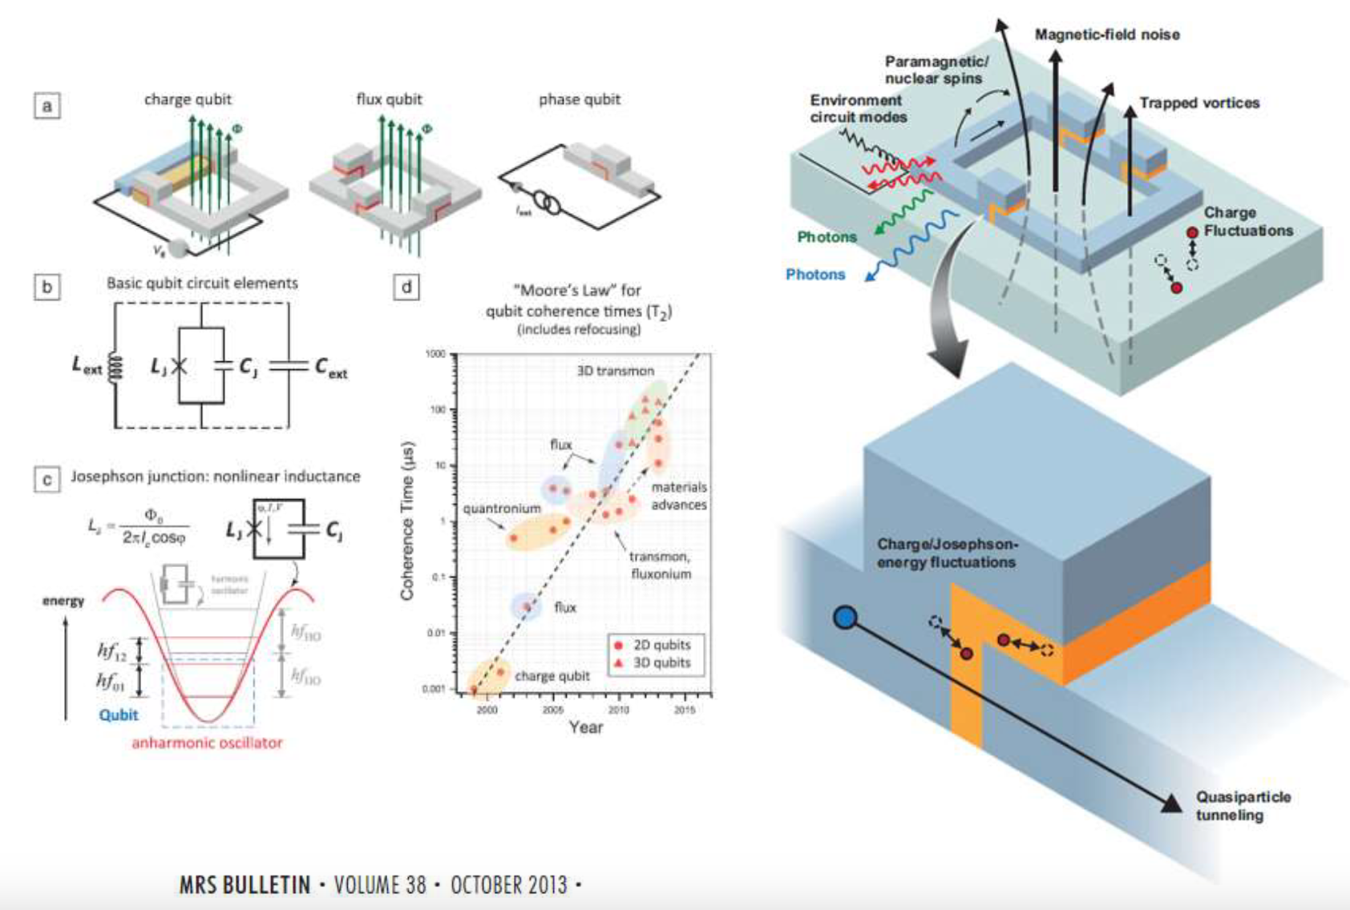
Quantum Qubit : Superconducting

Slide 10
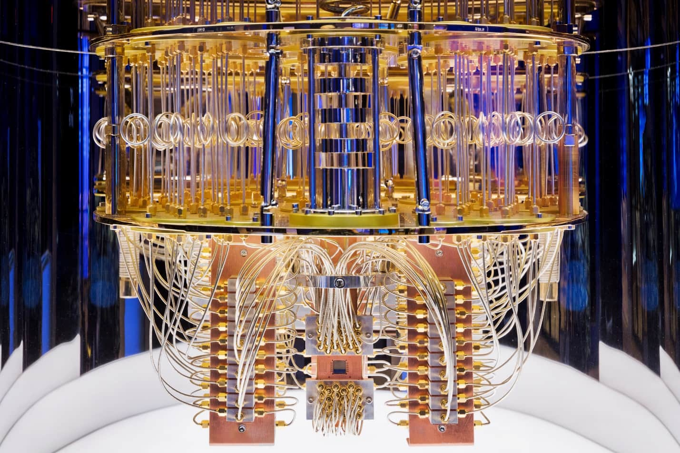
PRACTICAL REALITIES

Slide 11
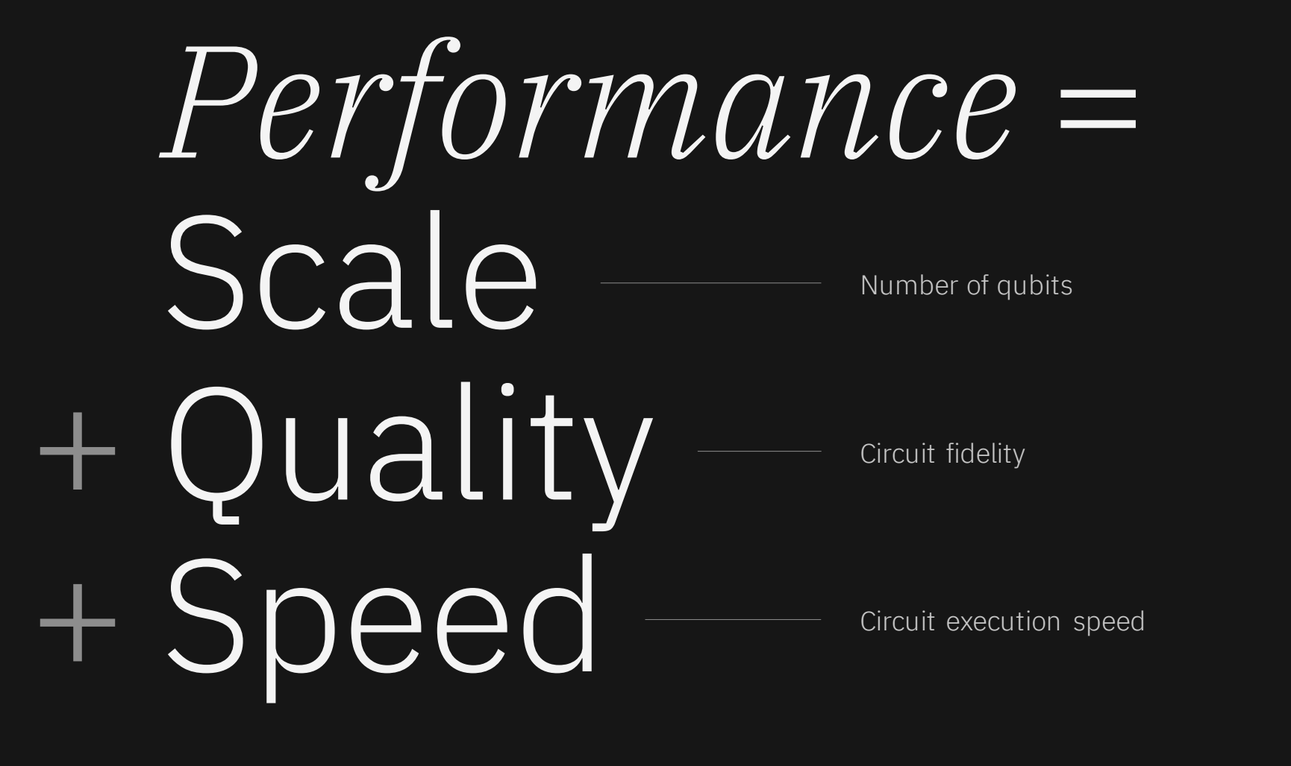
PRACTICAL REALITIES

Slide 12
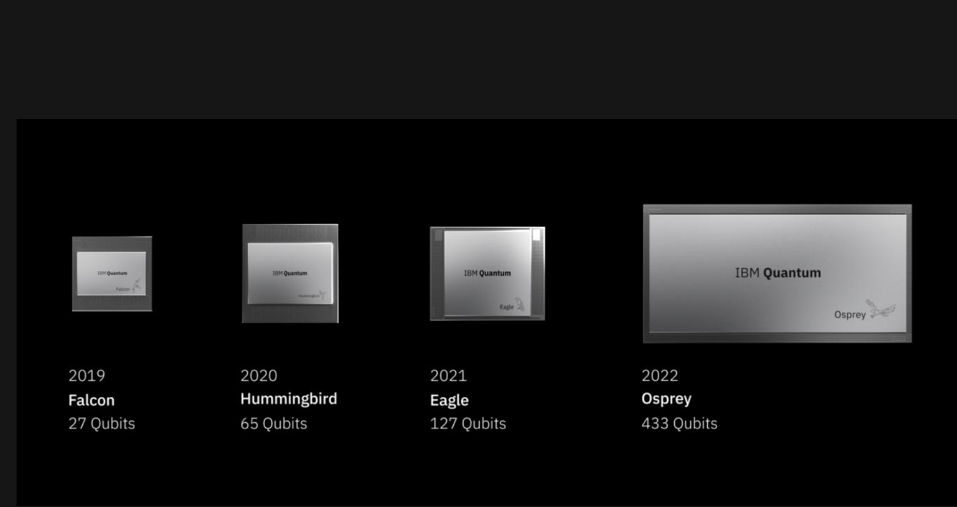
SCALE : NUMBER OF QUBITS

Slide 13
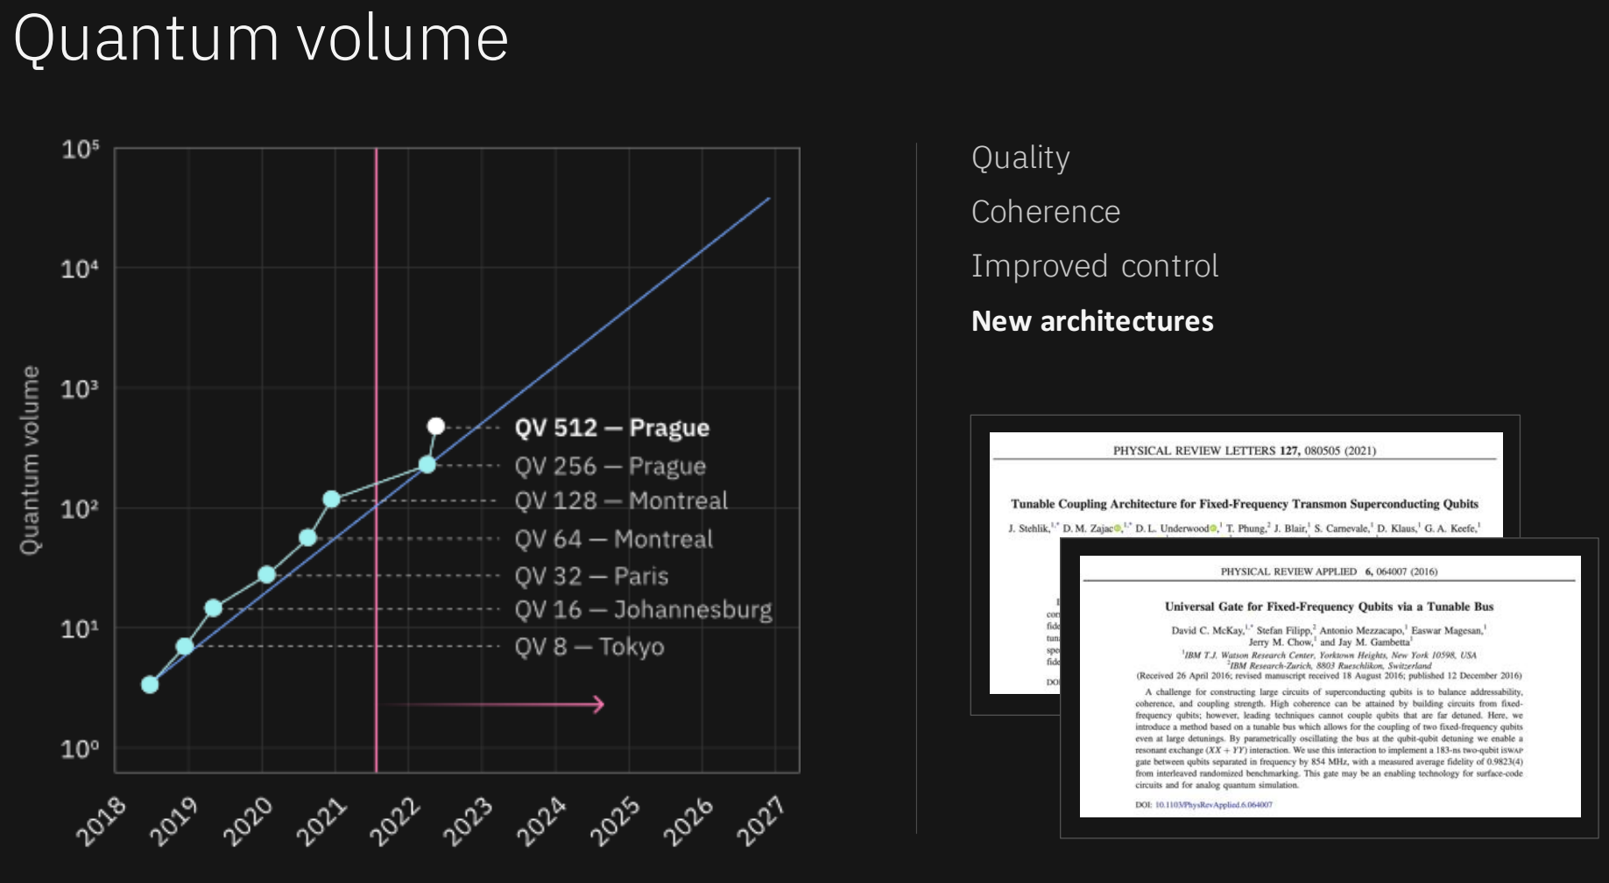
QUALITY : CIRCUIT FIDELITY

Slide 14
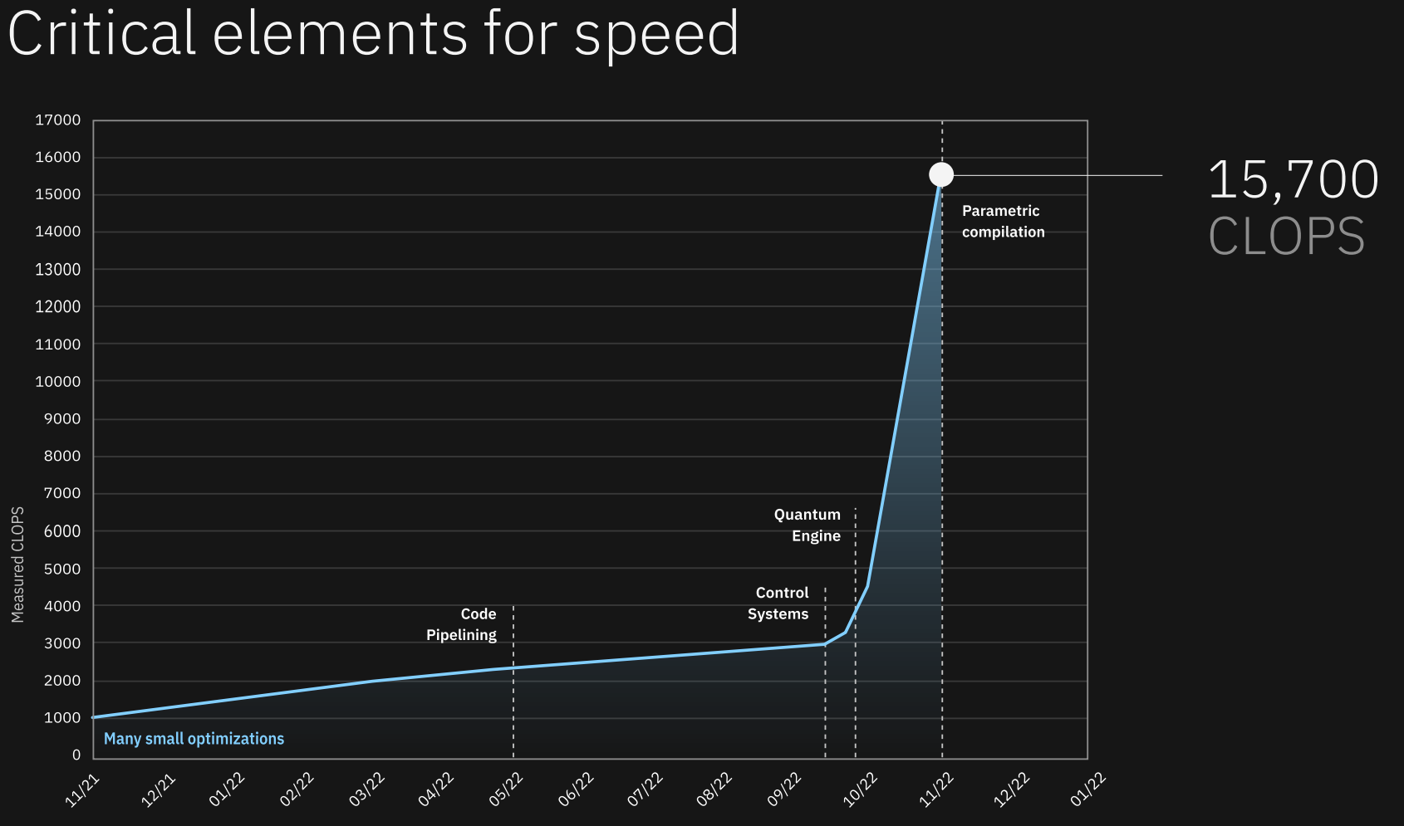
SPEED : CIRCUIT EXECUTION
Circuit Layer Operations per Second (CLOPS)
Measure of parallel and parameterized quantum operations a QPU can execute per unit of time.

Slide 15
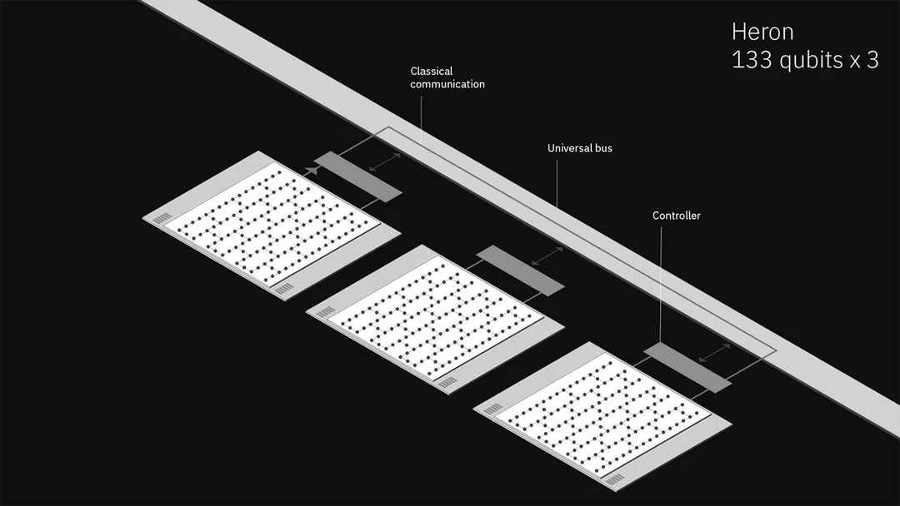
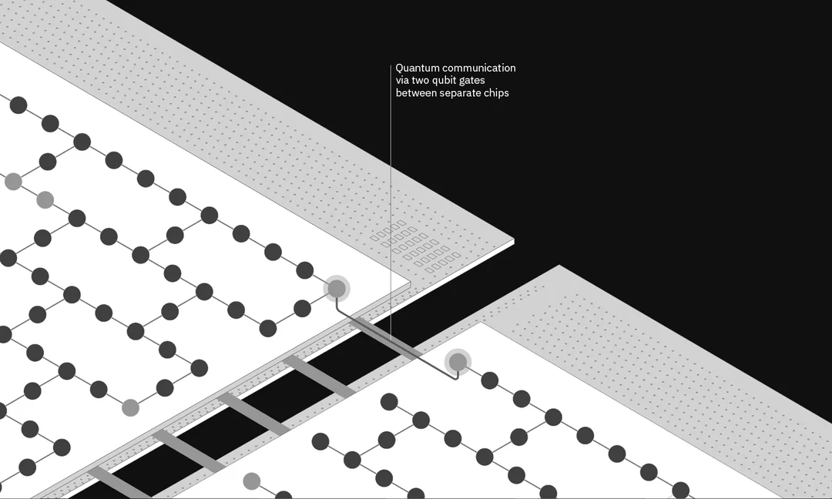
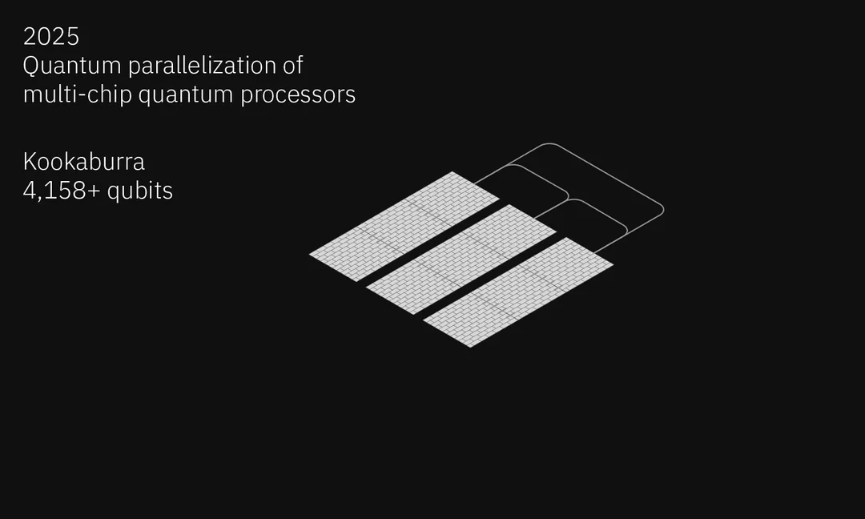
SCALING @ DISTRIBUTED APPROACH
Control Hardware :
Classical Communication
Multi Chip Processor
Quantum Parallelisation:
Built-in Quantum Communication Link

Slide 16
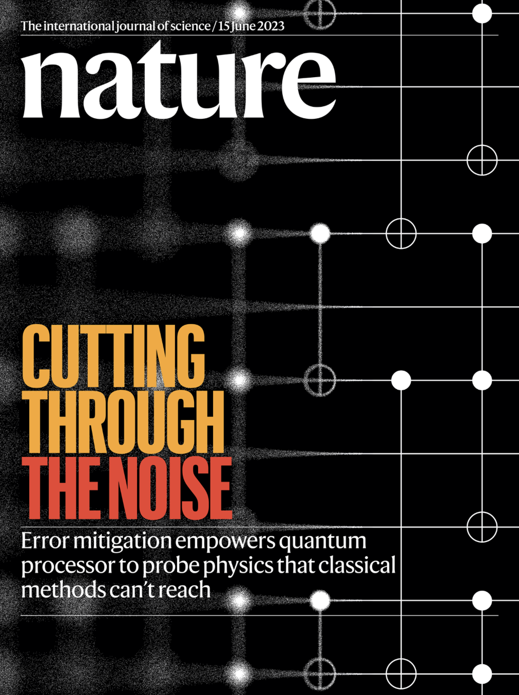
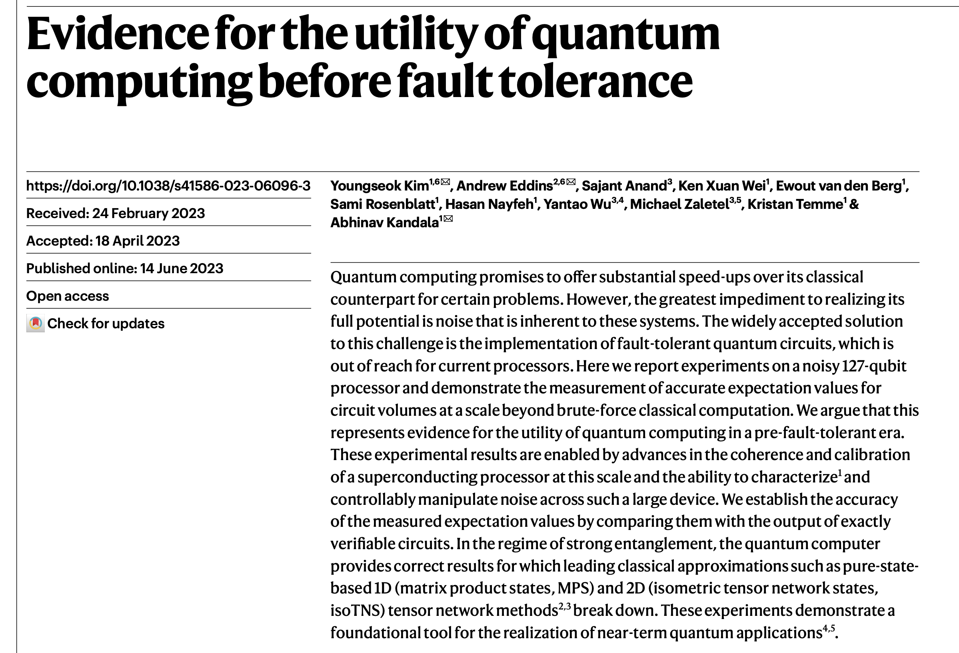
State of Quantum Utility
(Under Noisy Intermediate-Scale Quantum (NISQ) Constraints)

Slide 17
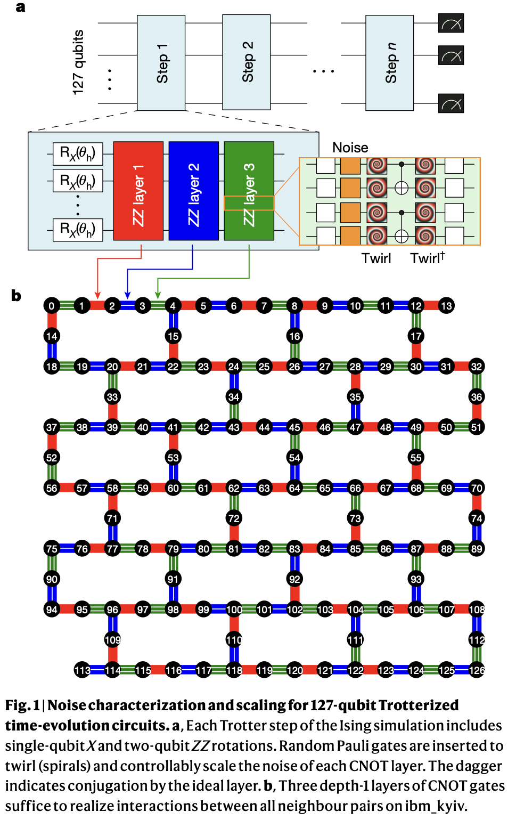
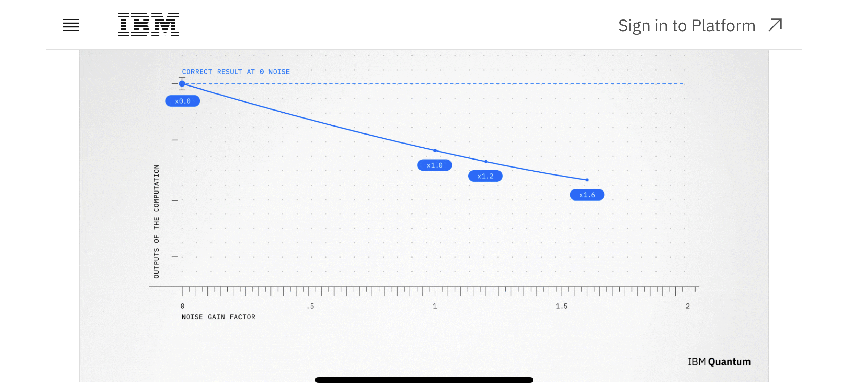
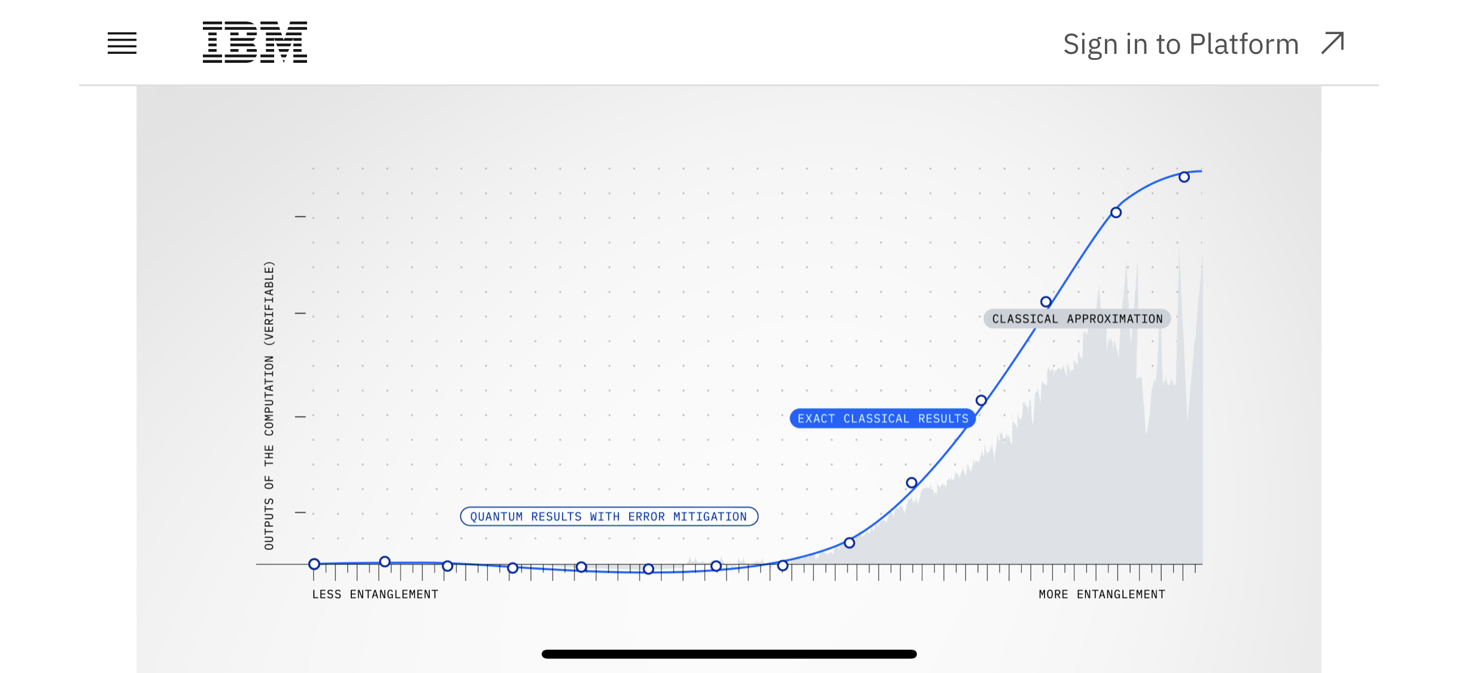
State of Quantum Utility

Slide 18
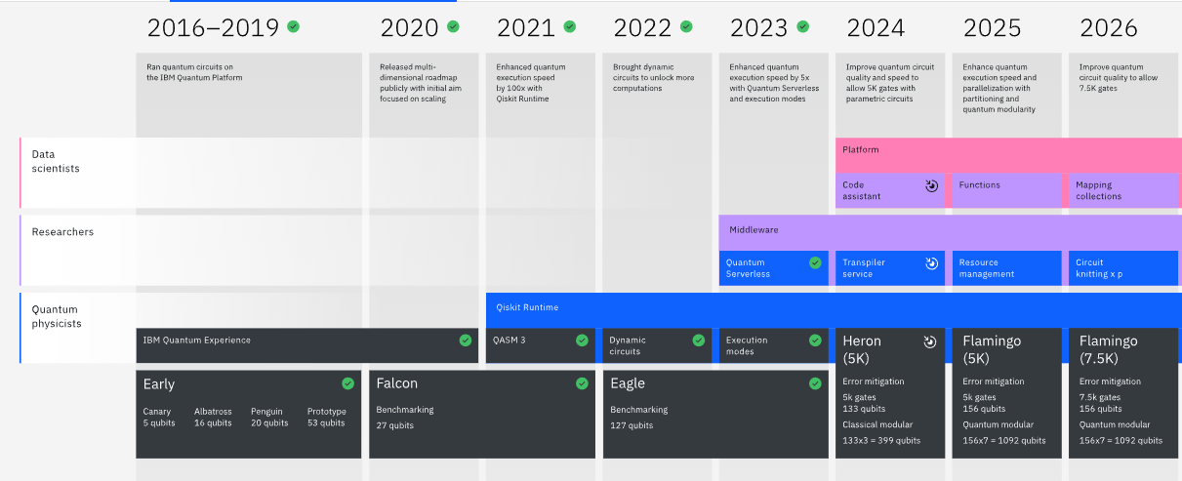
Status : Quantum Technology

Slide 19
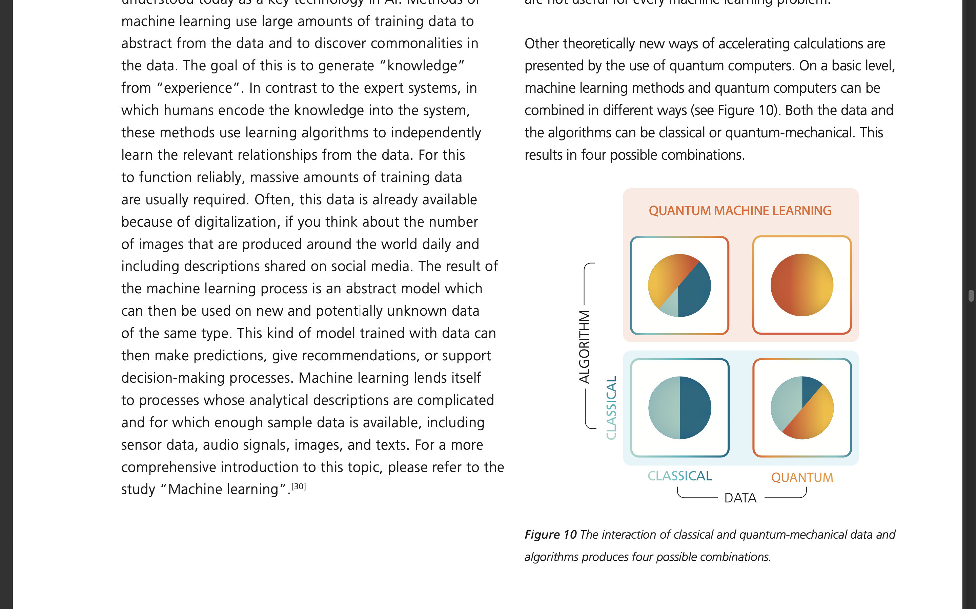
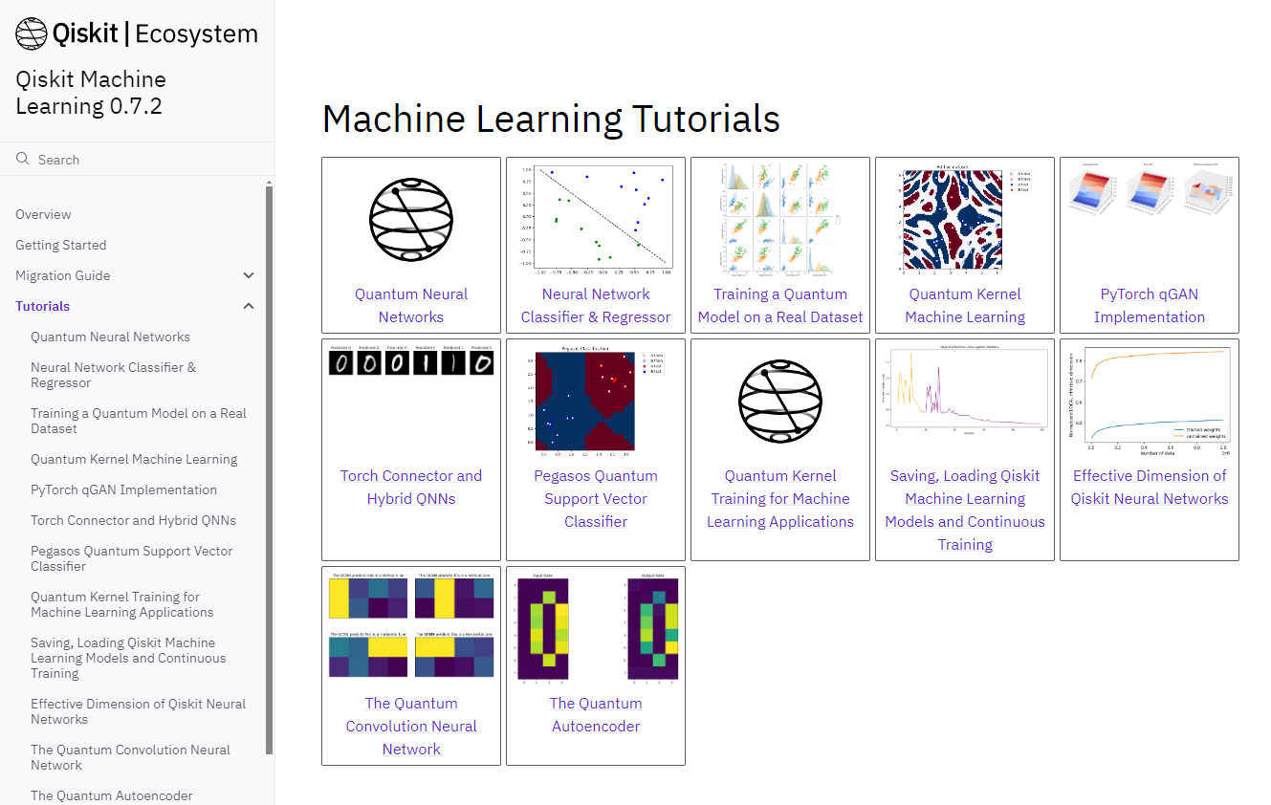
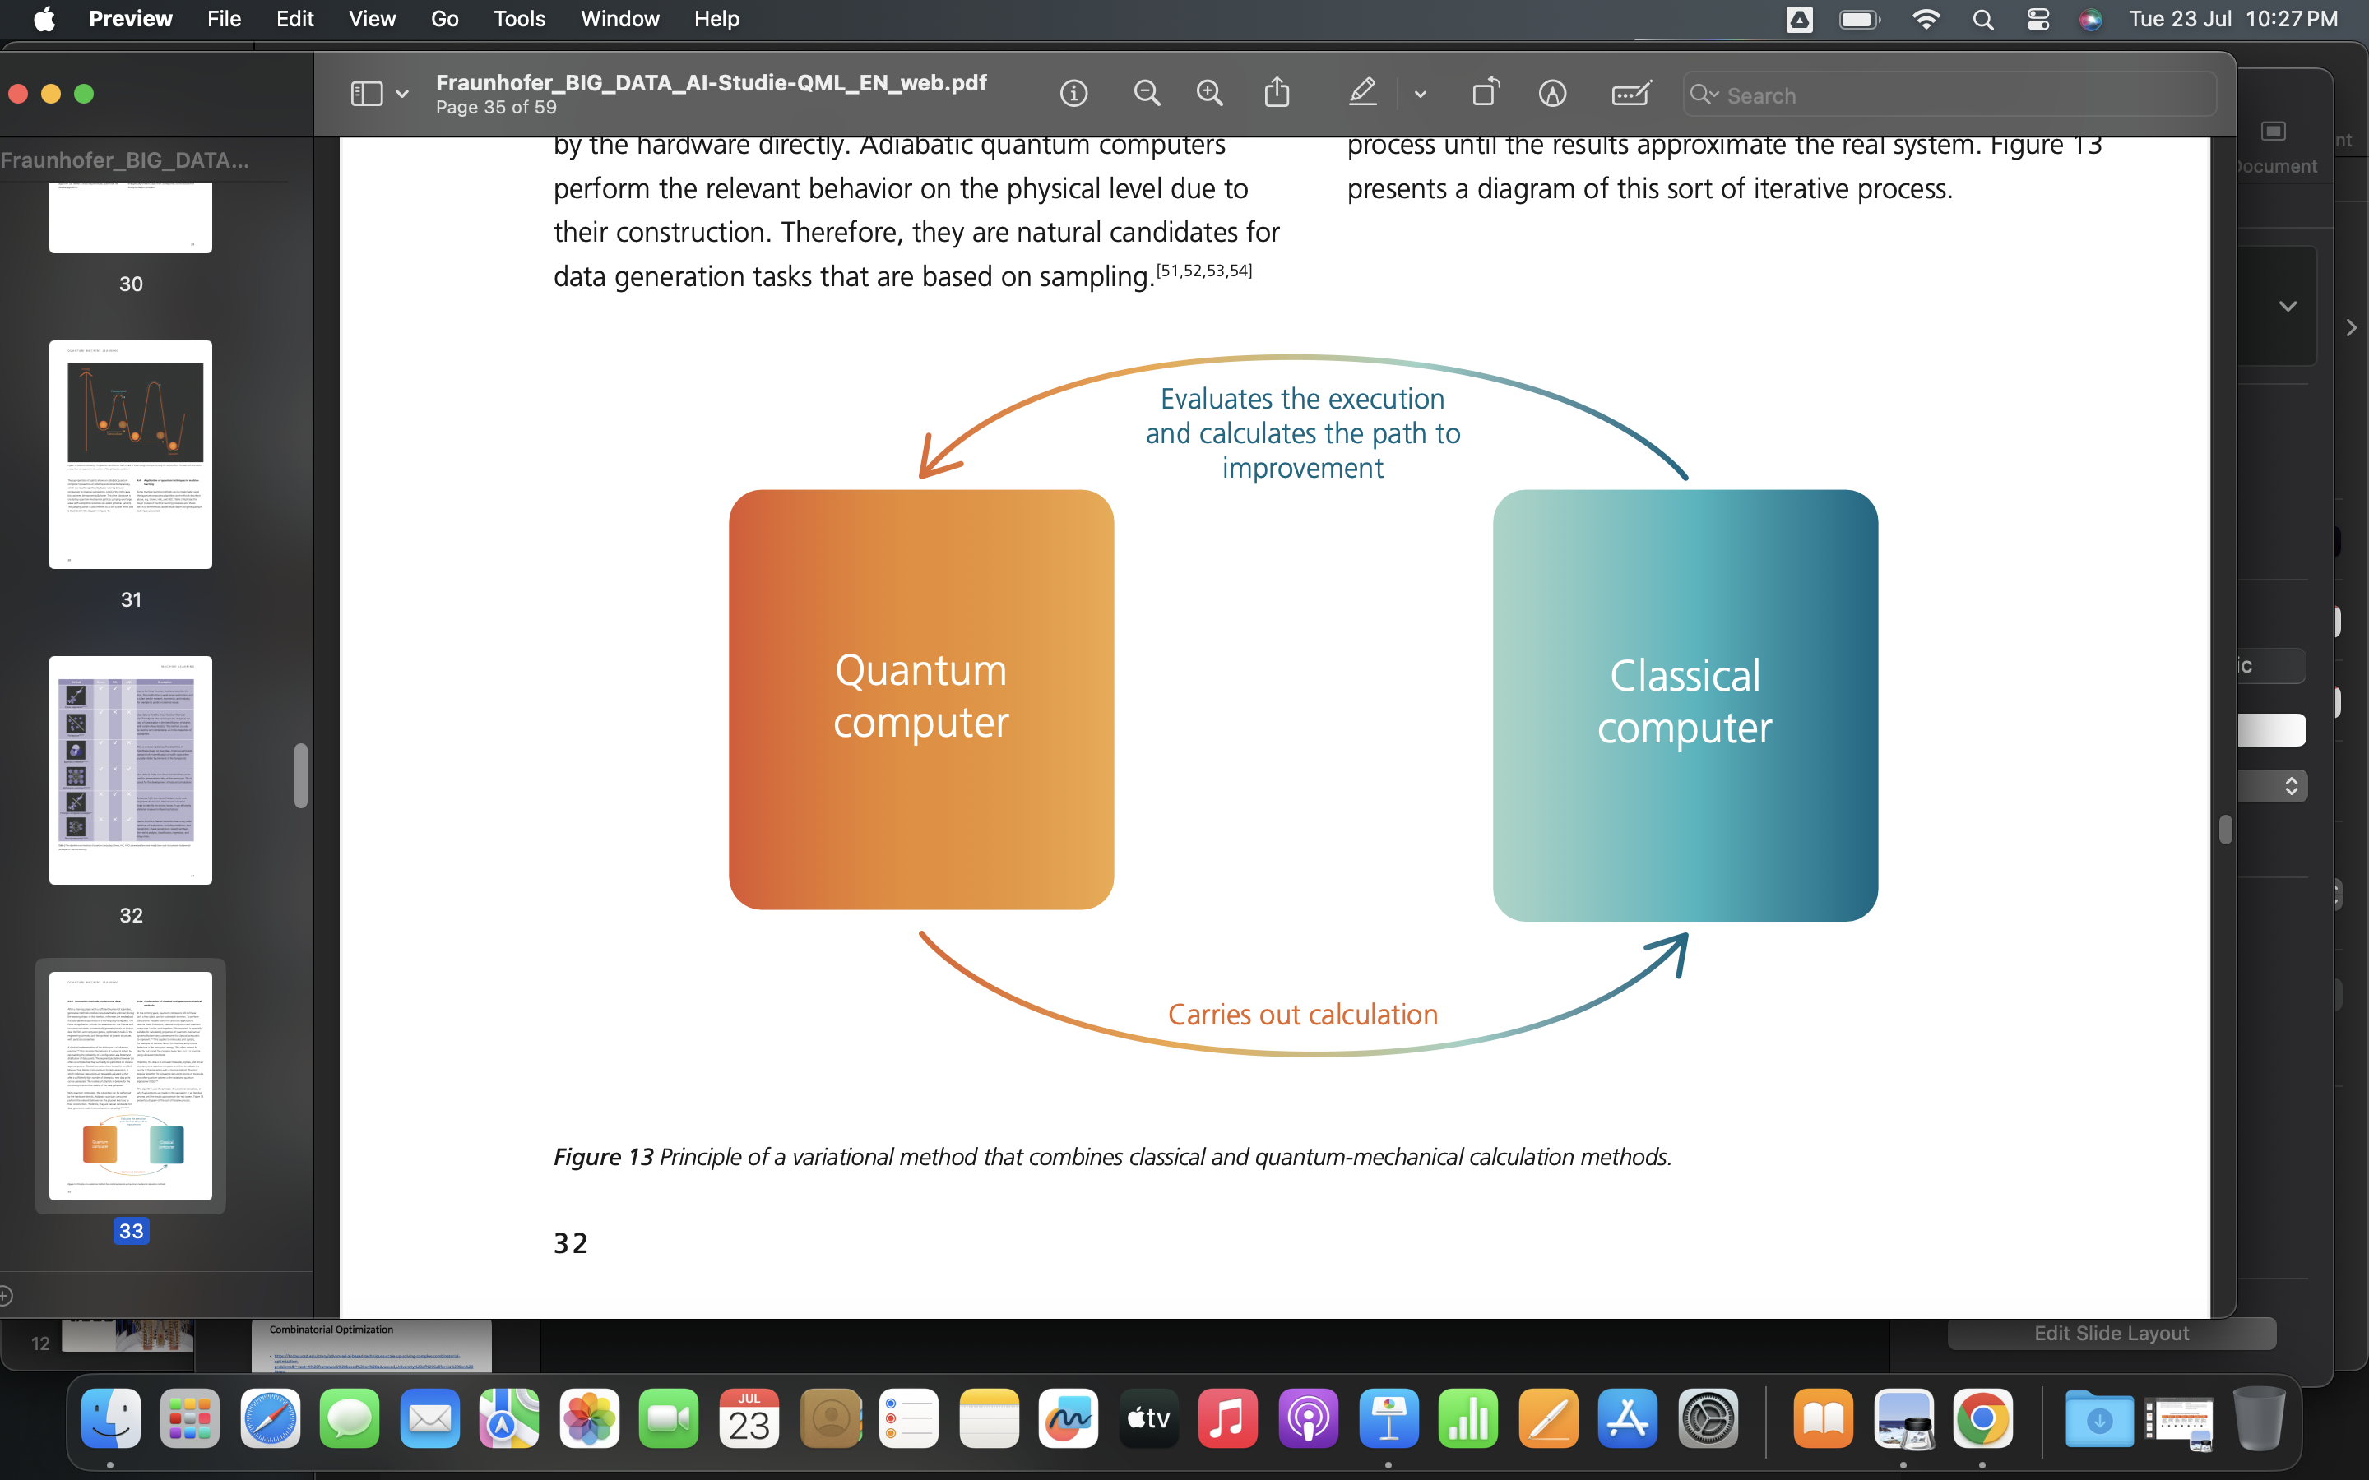
Quantum Machine Learning

Slide 20
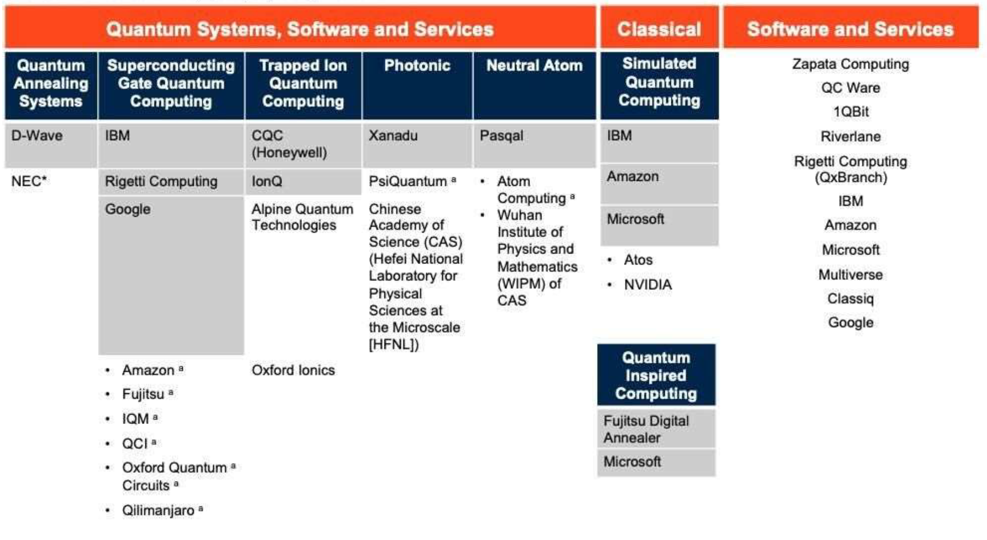
Quantum as a Service (QaaS)

Slide 21
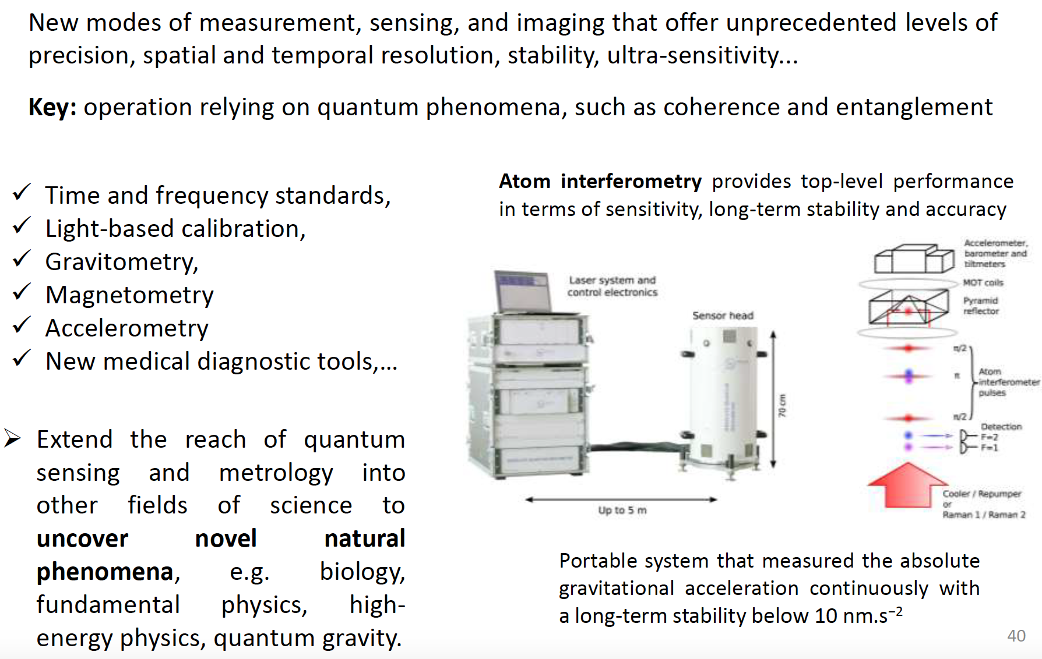
Quantum Sensing

Slide 22
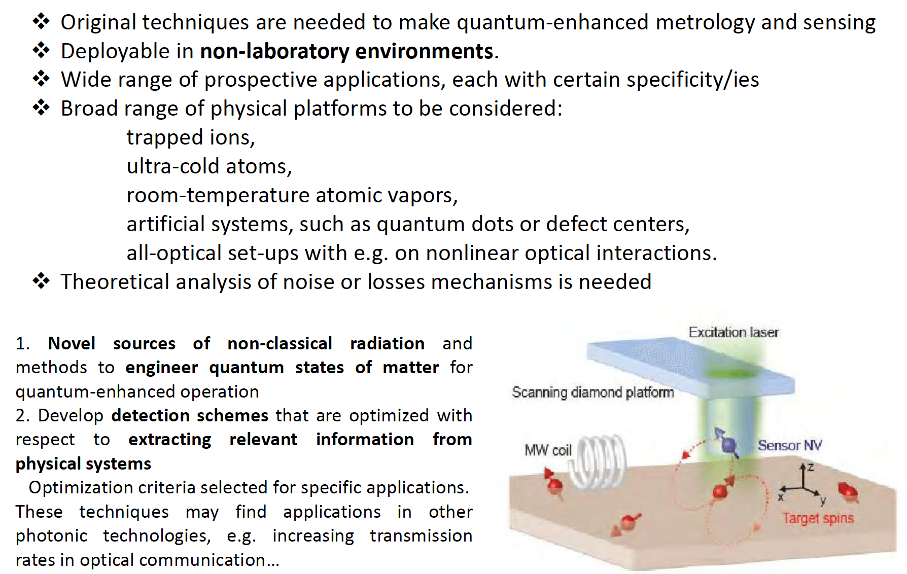
Quantum Enhanced Strategies

Slide 23
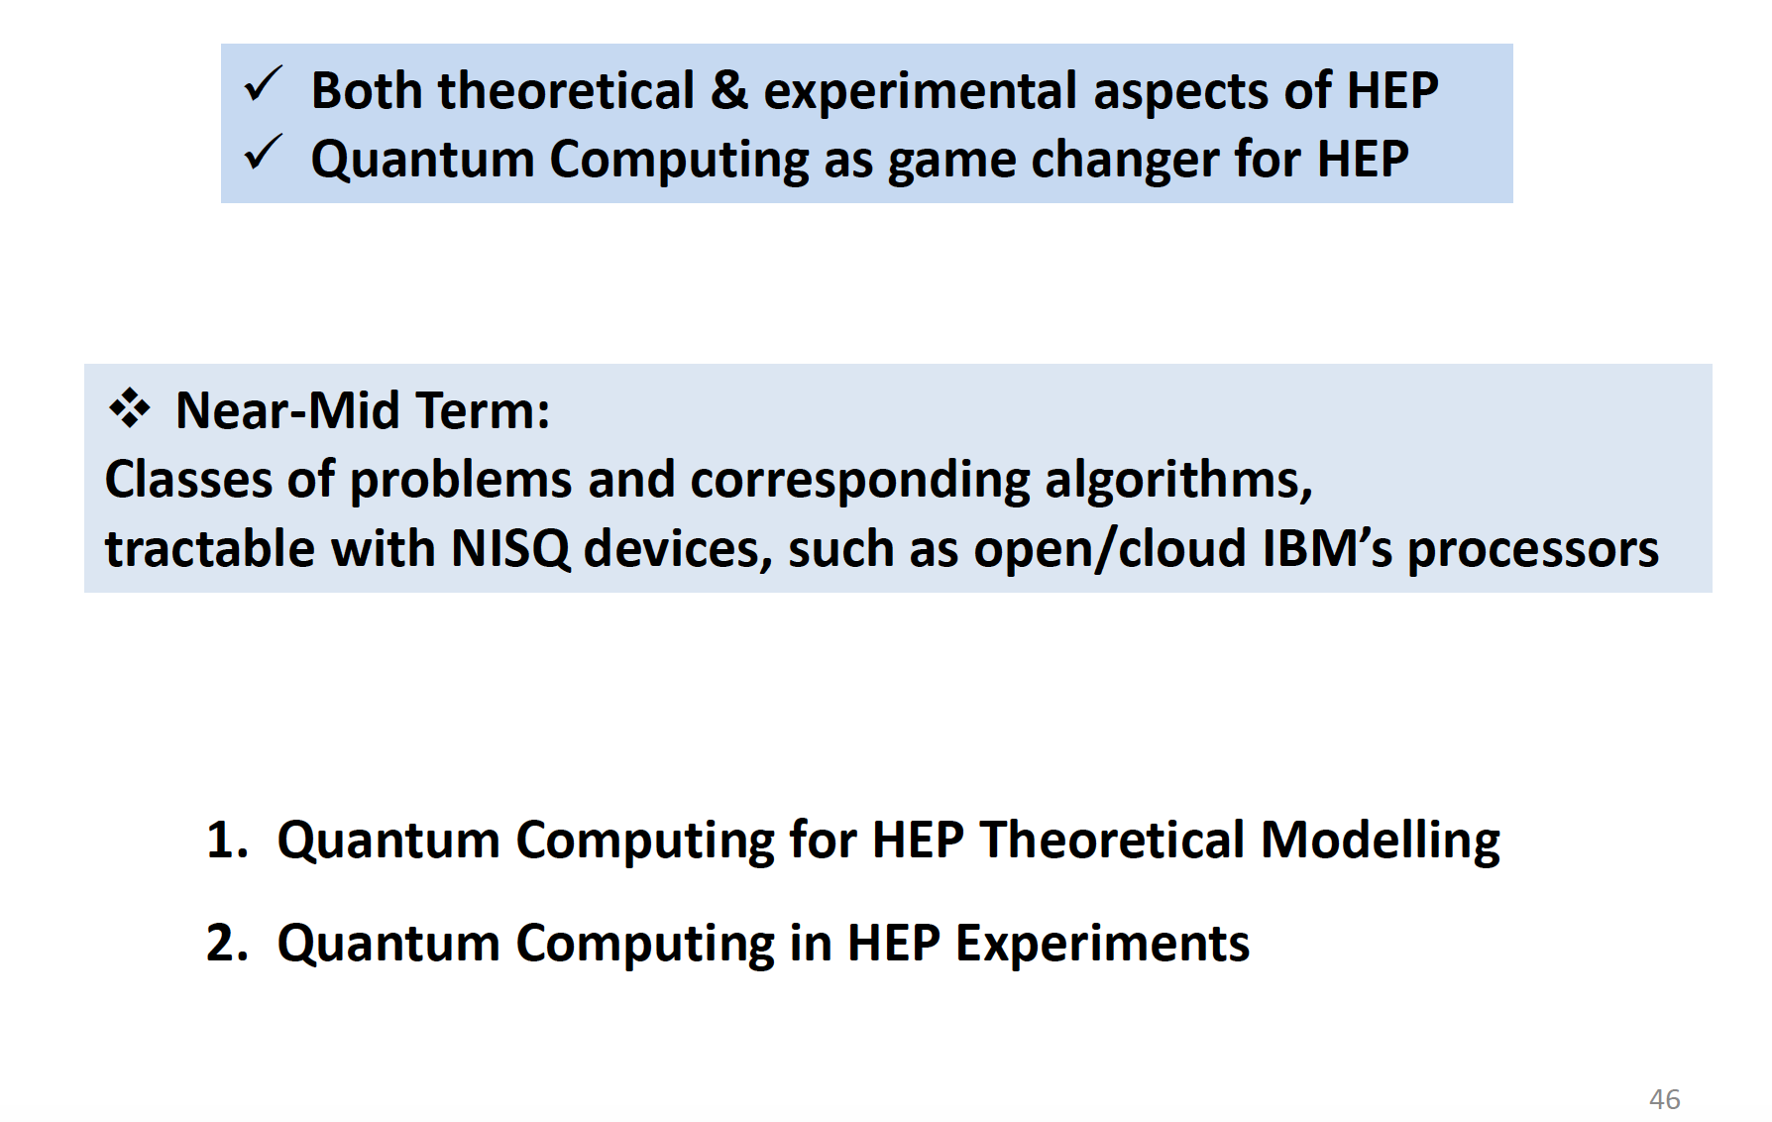
Quantum in High Energy Physics (HEP)

Slide 24
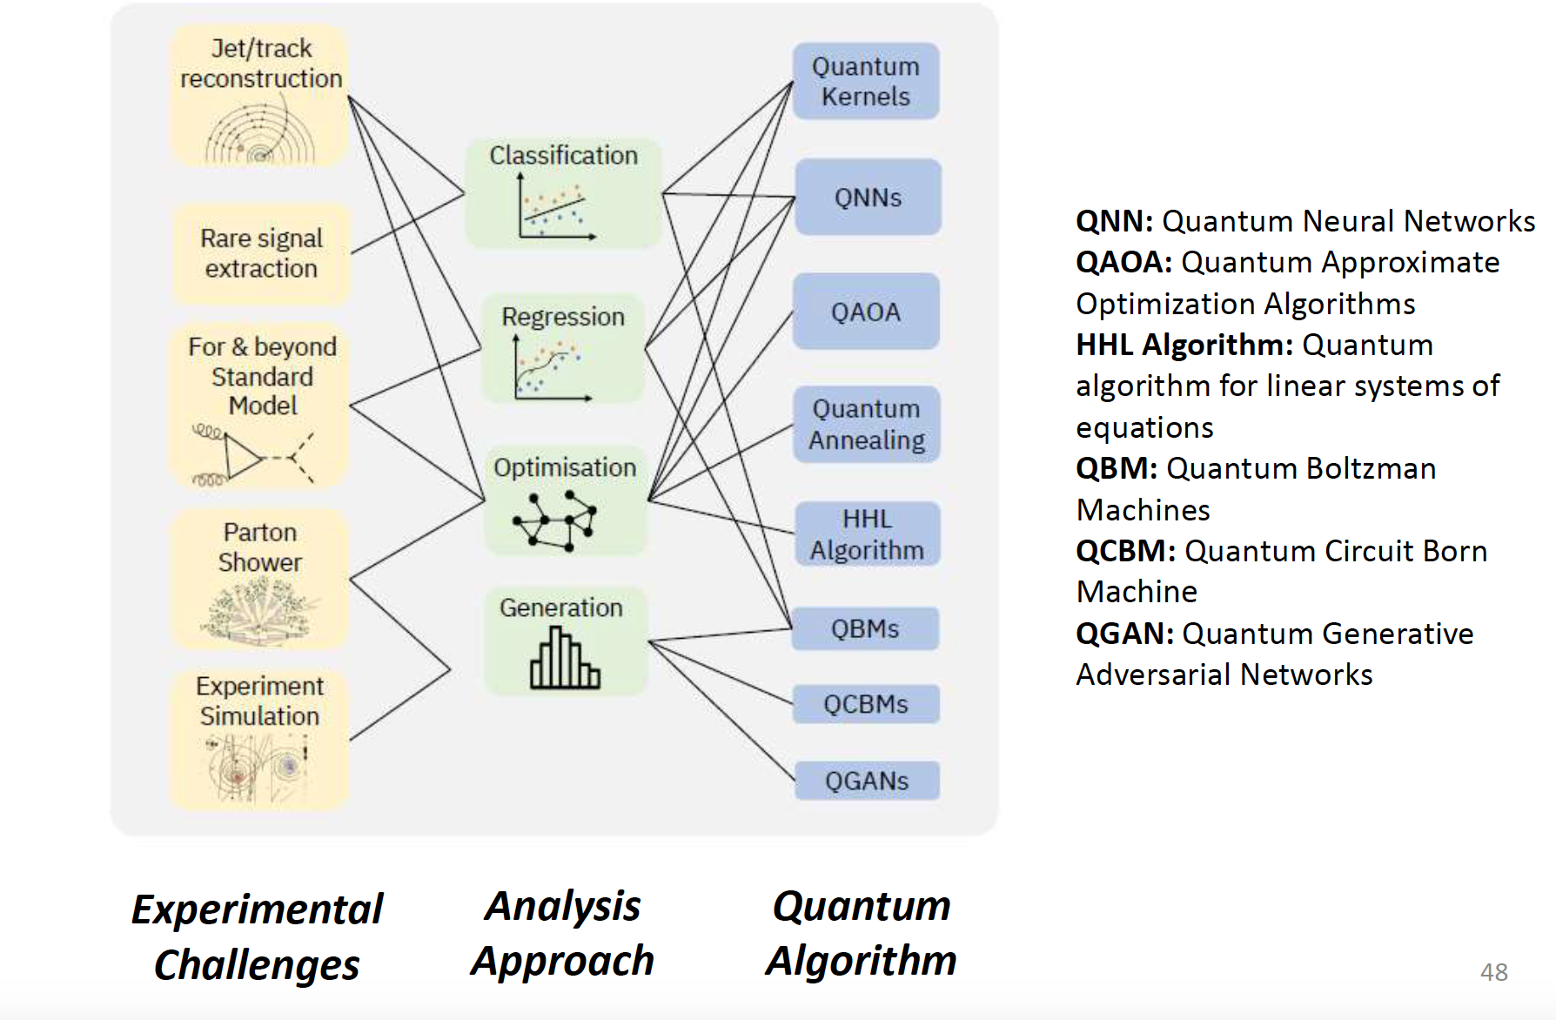
Quantum in HEP: Theoretical Modeling

Slide 25
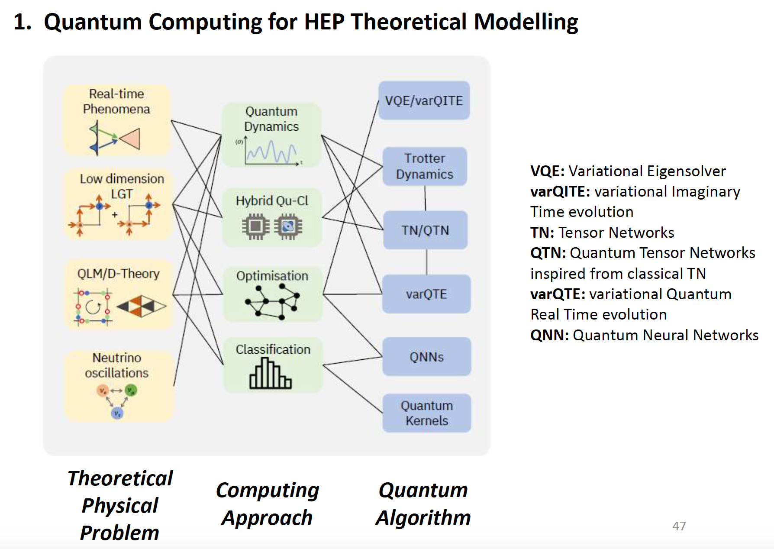
Quantum in HEP: Experiments

Slide 26
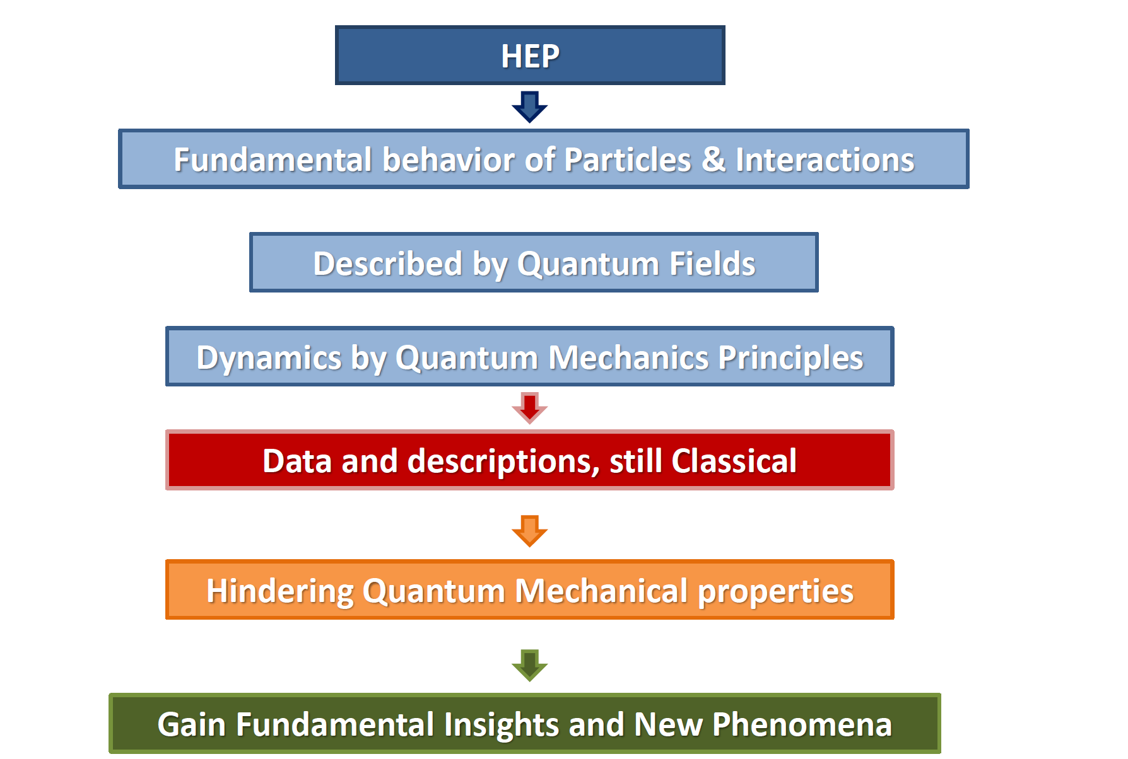
Quantum in HEP

Slide 27
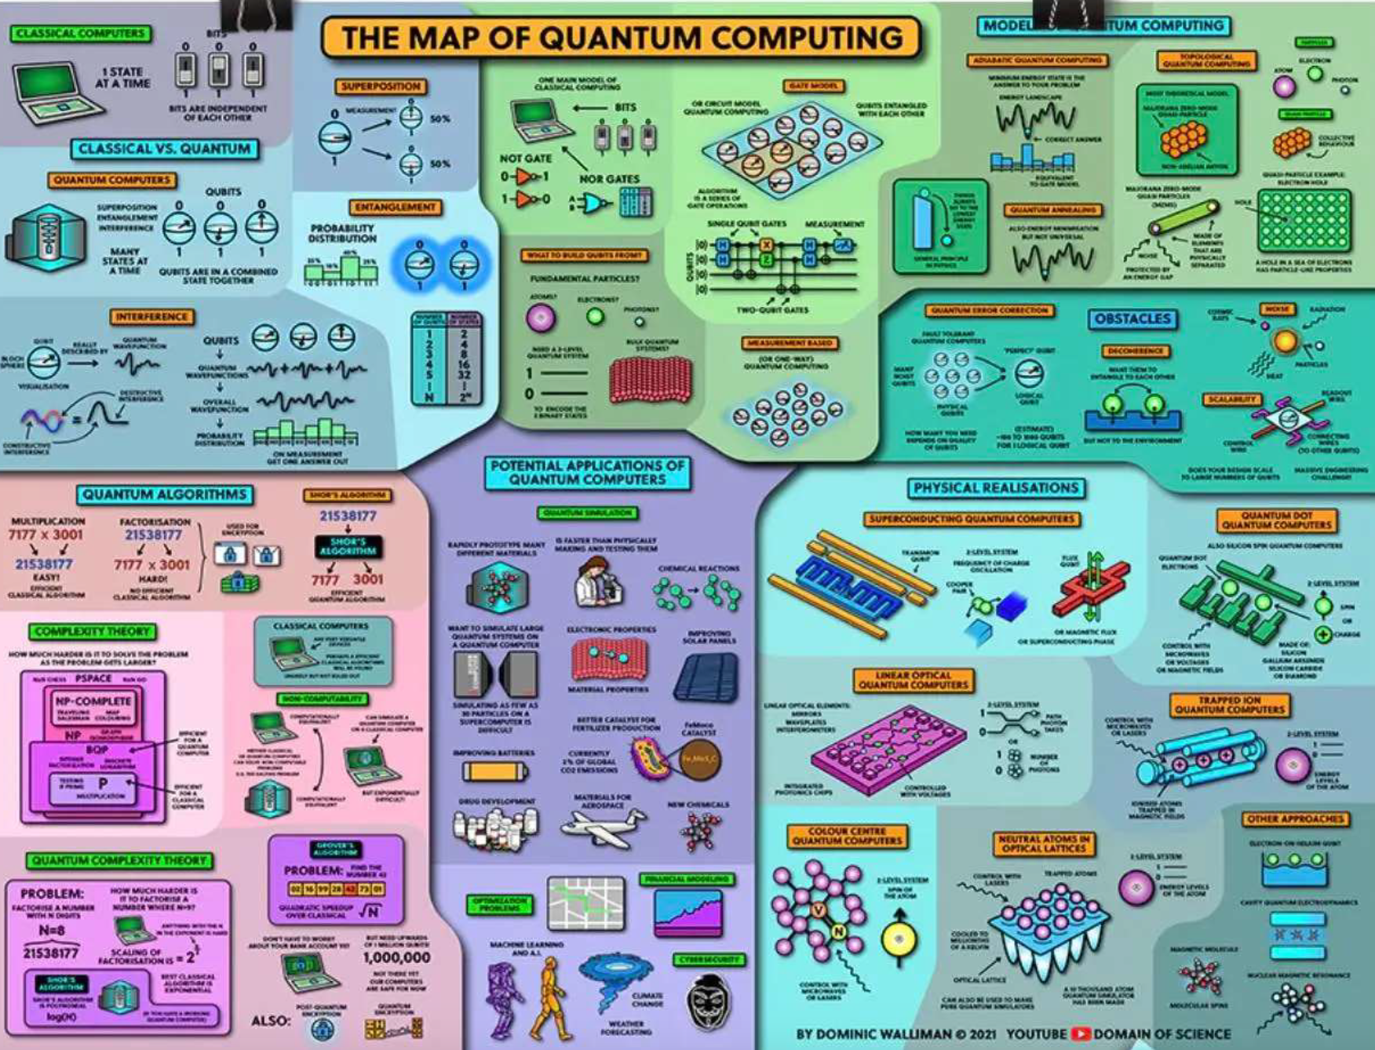

Slide 28







Thank
You
http://www.linkedin.com/in/k-jaiswal

